Slide 1

5S Refresher Course

Slide 2
Agenda
Safety & Health Contact
5S Package briefing
Site 5S audit
Assessment Review

Slide 3

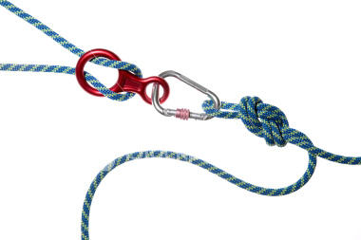
Safety & Health Contact

Slide 4
Course Content
Definition of 5S
Benefits of 5S
NatSteel Goals
Workstation Scoring Criteria
Practical Session (Roll play)

Slide 5
What is 5S?
5S is the short form for FIVE Japanese words:
SEIRI, SEITON, SEISO, SEIKETSU and SHITSUKE
Broadly translated, 5S means Good Housekeeping and Workplace Organization.

Slide 6
Meaning of 5S
Japanese | In English | Meaning | How to remember
SEIRI | Clearing | Sort out unnecessary items and discard them | Sort and Discard
SEITON | Organising | Arrange necessary items in good order A place for everything Everything in its place | Systematically Arrange
SEISO | Cleaning | Clean workplace and equipment thoroughly | Spick and Span
SEIKETSU | Maintaining | Maintain the clean, tidy condition | Standardise
SHITSUKE | Self-discipline | Doing what has been decided as a habit (conforming) | Self-discipline

Slide 7
1S - SEIRI - Clearing
What to look for:
  Unused/out dated/obsolete files, documents
  Damaged, defective machine
  Excess stocks
  Outdated notices, posters, forms, documents
  Junk mails

Slide 8
2S - SEITON - Organizing
Do you experience:
- a lot of searching, delays
- things get mixed up
- missing items from shelves
Set-up a storage/filing system where things are:
- Easy to see – proper labels and markings
- Easy to take – neatly arranged & stacked
- Easy to return – no obstruction

Slide 9
3S - SEISO - Cleaning
Floor is clean – litter, rubbish
Storage areas – racks, cabinets, boxes
Equipment – PC, workstation
Documents – files, drawings, record books,

Slide 10
4S - SEIKETSU - Maintaining
Develop a routine and practice it until it becomes a habit
- cleaning schedule (eg. every day 15 min clean up (before start work)
- 5S corner in bulletin boards
- targets are set in the Department

Slide 11
5S - SHITSUKE - Self-discipline
Conforming to the 5S rules without being told
Organizing own workstation daily
Cleaning workstation habitually
New files are being labelled
Being proactive when we see something not right

Slide 12
Benefits of 5S
Safety
Preventing
Accidents
Quality
Preventing
Human Errors
5S
Productivity
Eliminating
Waste
Equipment
Performance
Reducing
Downtime

Slide 13
NatSteel Goals
Vision
To create a 5S culture in our organization which we can call our workplace, our home.
Mission
To achieve a clean, neat and safe workplace by adopting 5S practices at all levels at all times.
Performance Measures
Measure 5S performance in each work area
Set up measurement and reward system to reward team
Carry out quarterly audit using checklist and score sheet
Create friendly competition with reward and recognition

Slide 14

Three Classes of workplace
1st Class | 2nd Class | 3rd Class
Nobody makes a mess or throws things around, yet everyone helps to keep the place clean. | Some people make a mess and throw things around, but there are office cleaners who tidy up the place | Everyone makes a mess, throws things around and nobody bothers to clean the place up

Slide 15
If workplace is classified under either 2nd class or 3rd class – it is time to put 5S into action.
On the other hand, even if your workplace has already achieved first-class status, you could still consider ways to further improve your work environment.

Slide 16
A first-class workplace could be achieved ……
If all employees are involved and everyone strives towards a clean, organized workplace.
Click me

Slide 17
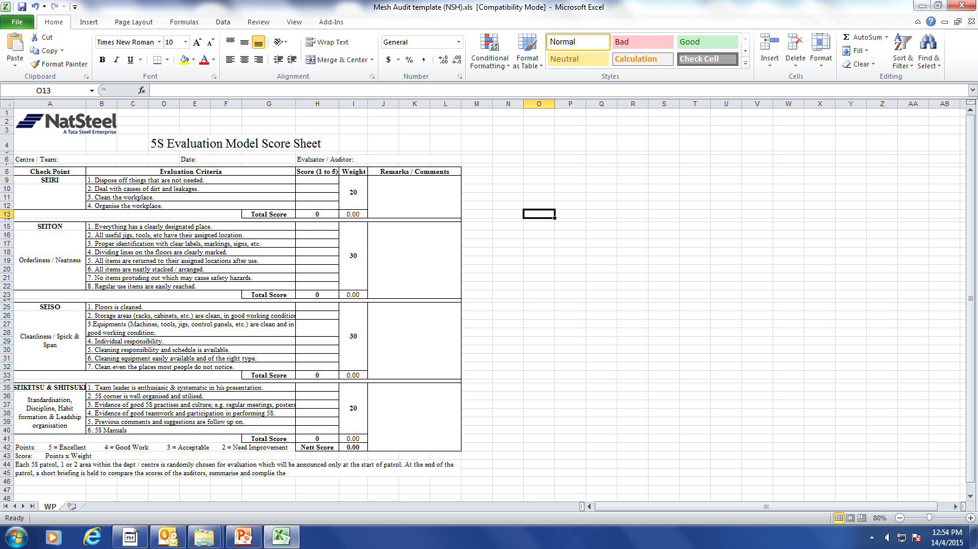
Production Scoring Sheet

Slide 18
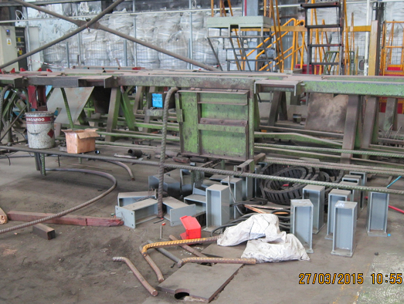
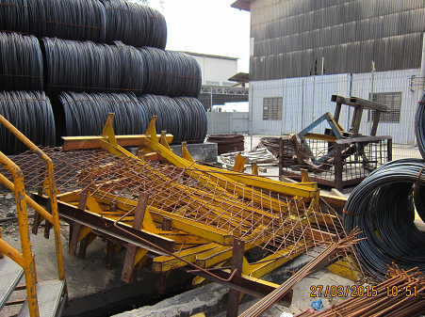
5S Workstation Scoring
Rating (pt) | 0 | 1 | 2 | 3 | 4 | 5

Slide 19
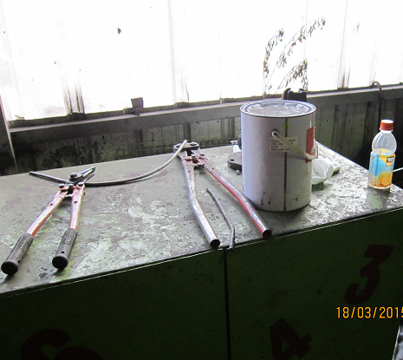
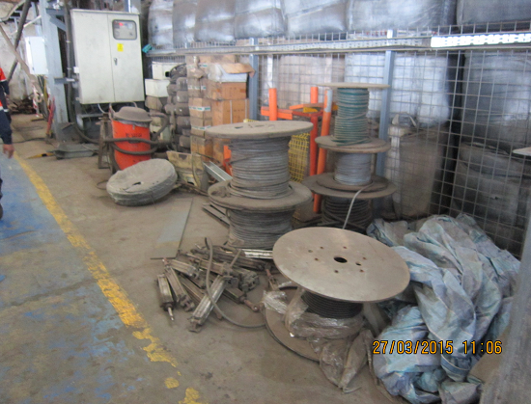
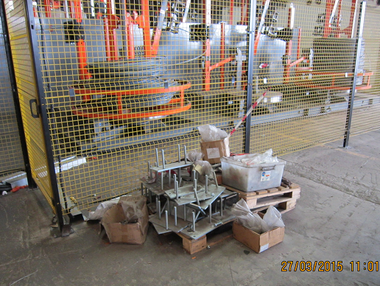
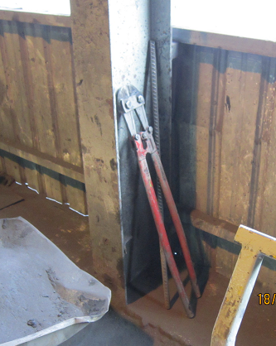
5S Workstation Scoring
Rating (pt) | 0 | 1 | 2 | 3 | 4 | 5

Slide 20
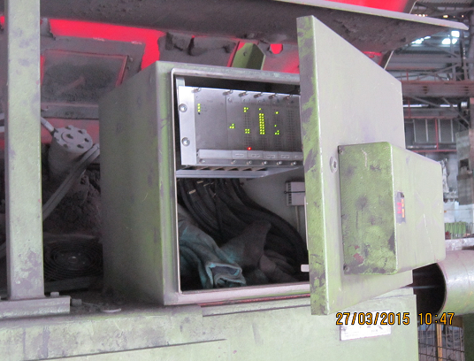
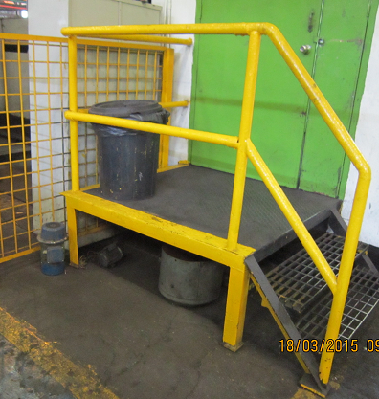
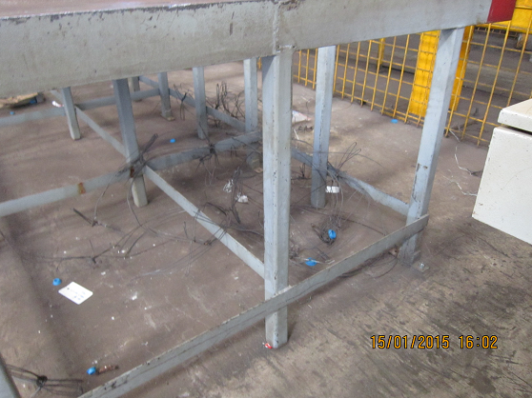
5S Workstation Scoring
Rating (pt) | 0 | 1 | 2 | 3 | 4 | 5

Slide 21
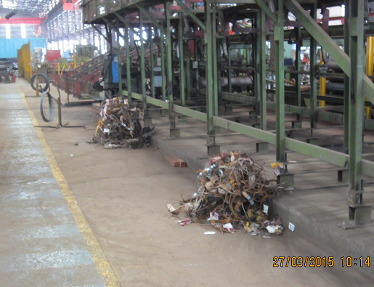
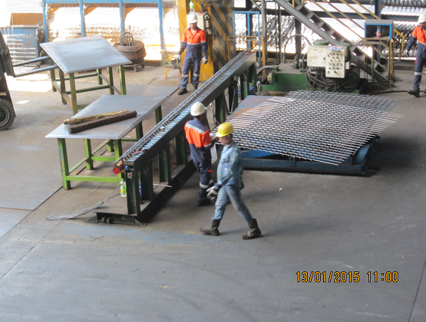
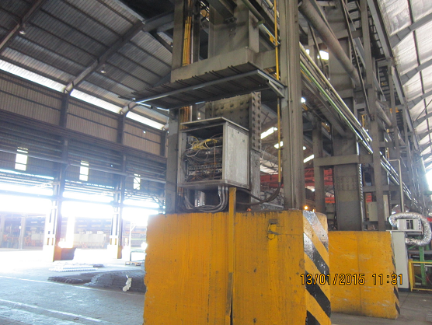
5S Workstation Scoring
Rating (pt) | 0 | 1 | 2 | 3 | 4 | 5

Slide 22
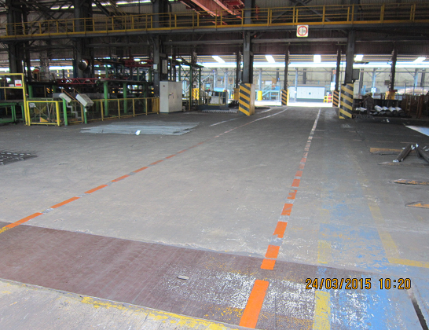
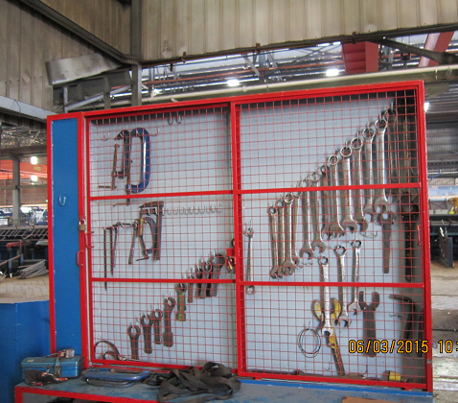
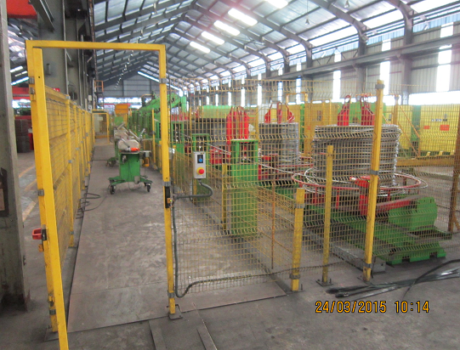
5S Workstation Scoring
Rating (pt) | 0 | 1 | 2 | 3 | 4 | 5

Slide 23
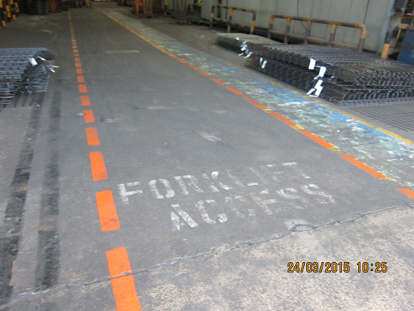
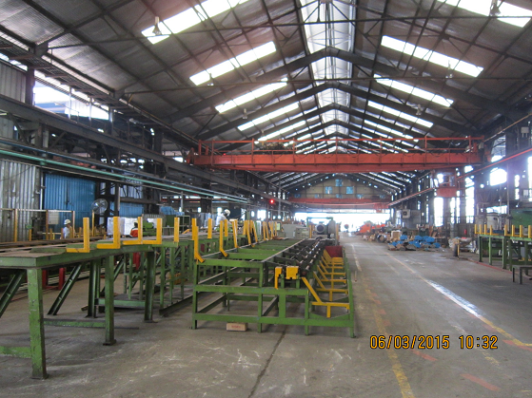
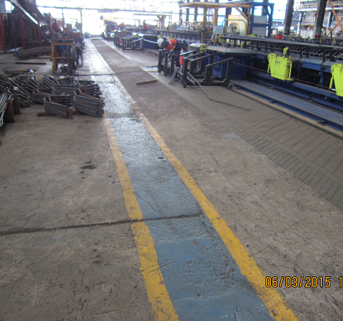
5S Workstation Scoring
Rating (pt) | 0 | 1 | 2 | 3 | 4 | 5

Slide 24
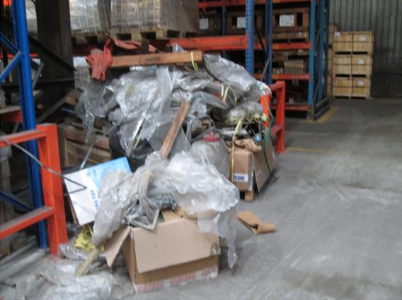
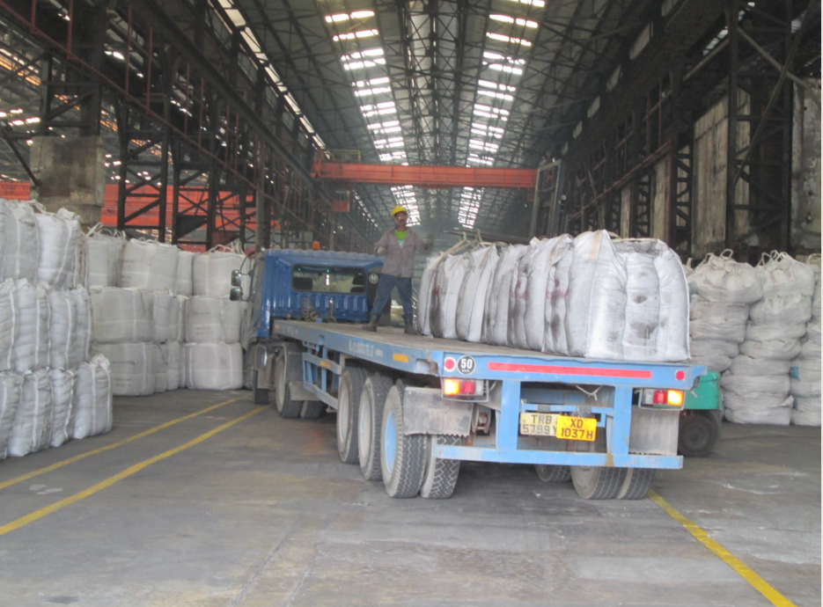
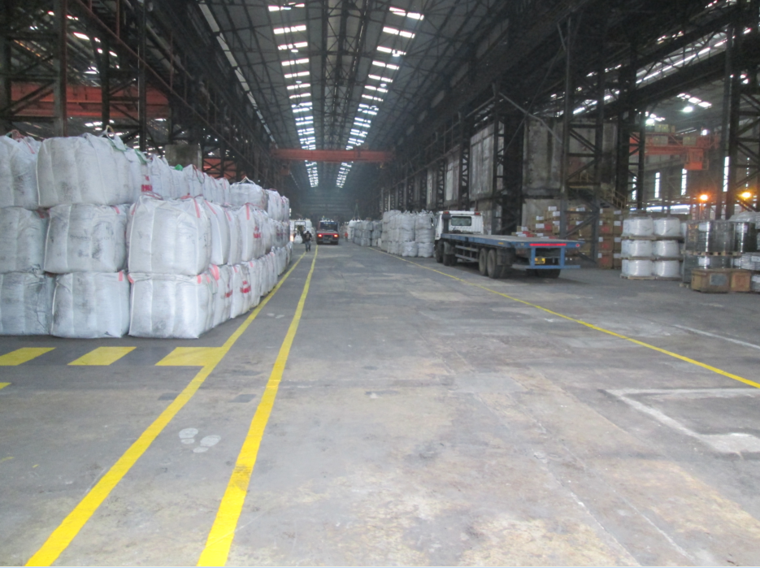
How much score do you give?

Slide 25
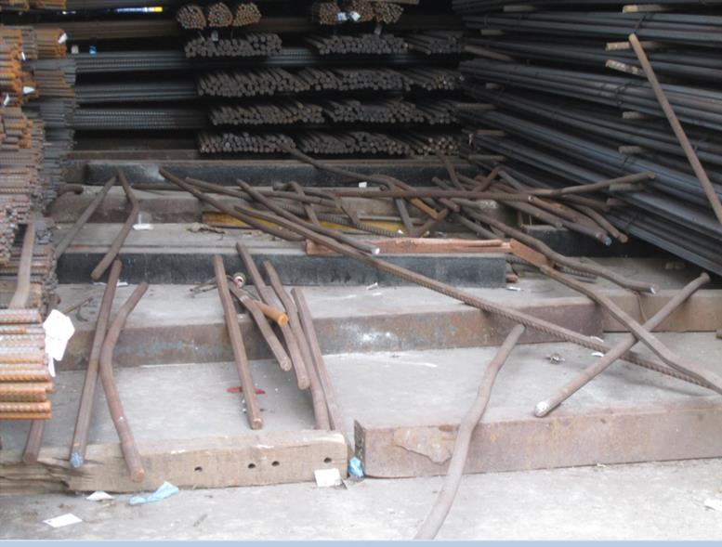
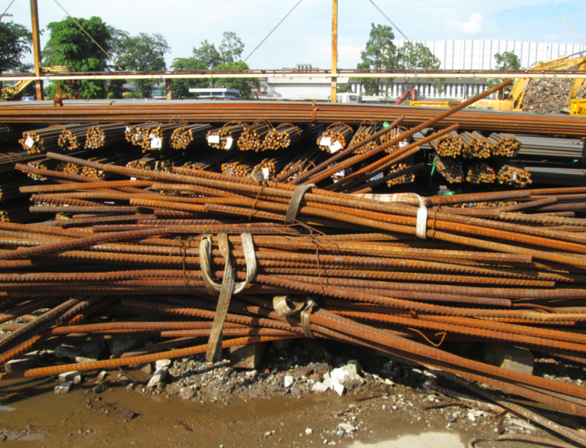
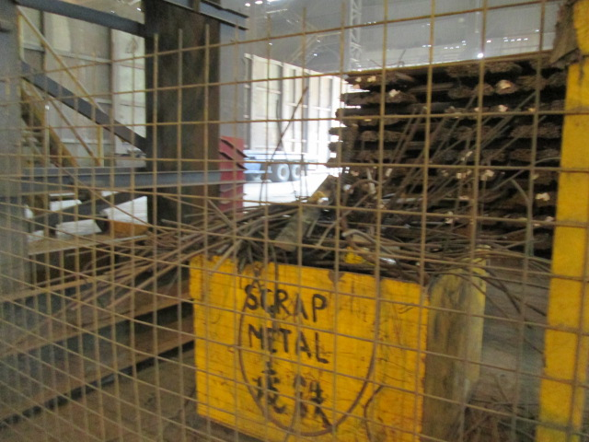
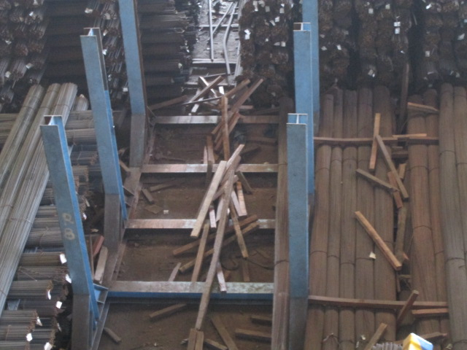
How much score do you give?

Slide 26
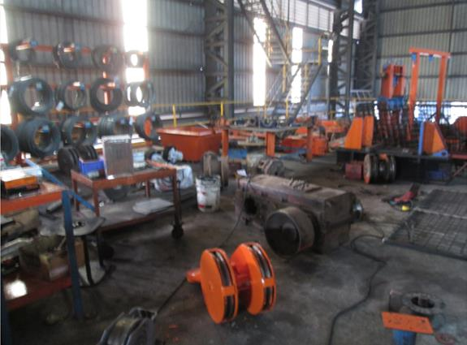
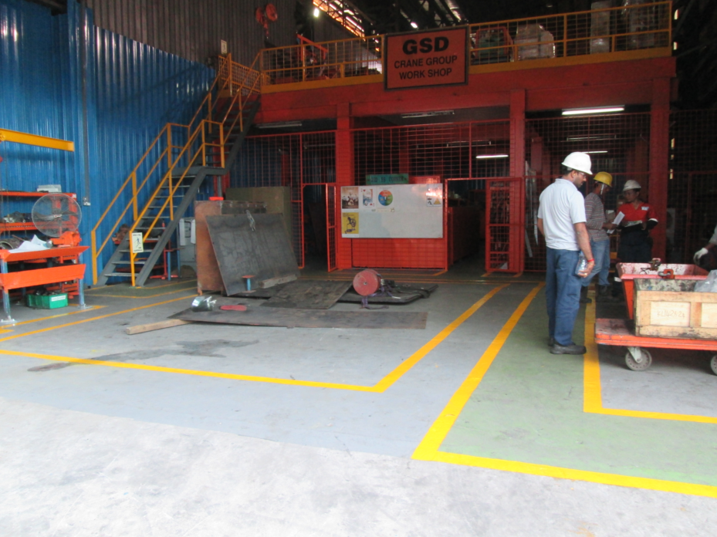
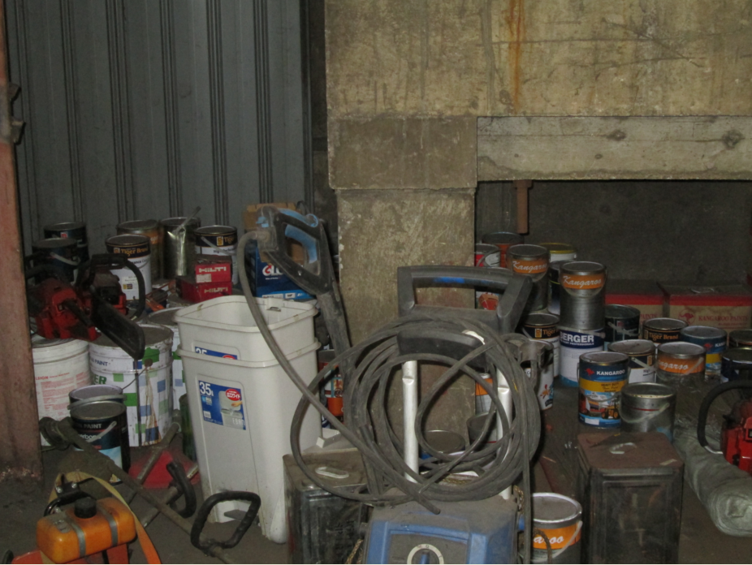
How much score do you give?

Slide 27
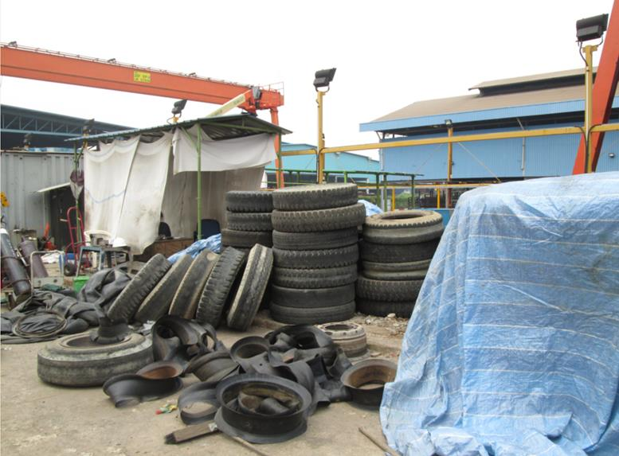
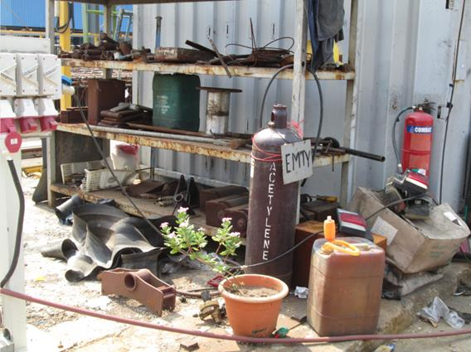
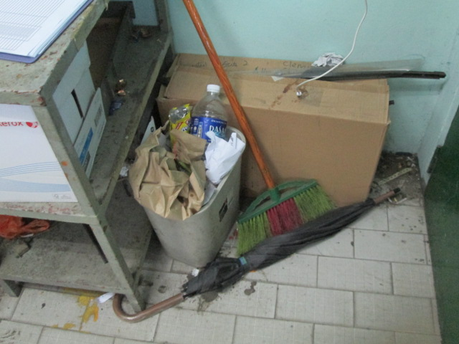
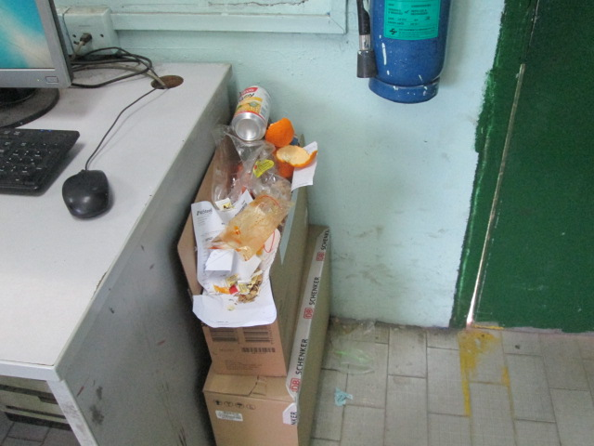
How much score do you give?

Slide 28
5S Team Leader Assignment
To ensure everyone involve in daily housekeeping
To achieve clean, neat and tidy workplace everyday
To take photo on current status, IC’s will then take action on closure (stetting up standard)
Hall IC’s to set standard for halls and submit own areas report
Conduct weekly/monthly audit including surprise audit
Submit audit results to see your actual scoring

Slide 29
CONCLUSION
5S IS NO EASY
“The 5S’s are not that difficult to understand. However, they are very difficult to do well. They require diligence and determination. They require constant effort and require the ability to see what is important and to pay attention to details.
They may not show dramatic results, but they do show results.”
5S

Slide 30
THANK YOU
THE END

